Slide 1
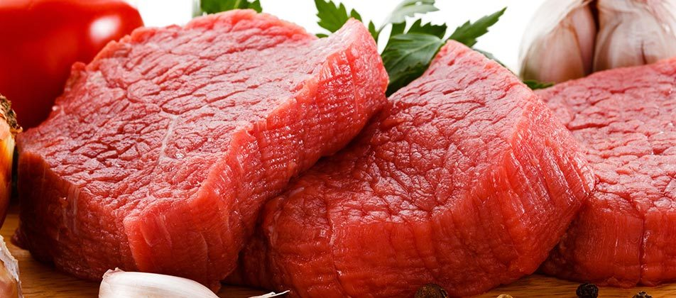
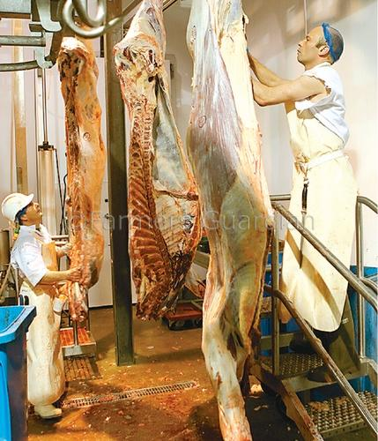
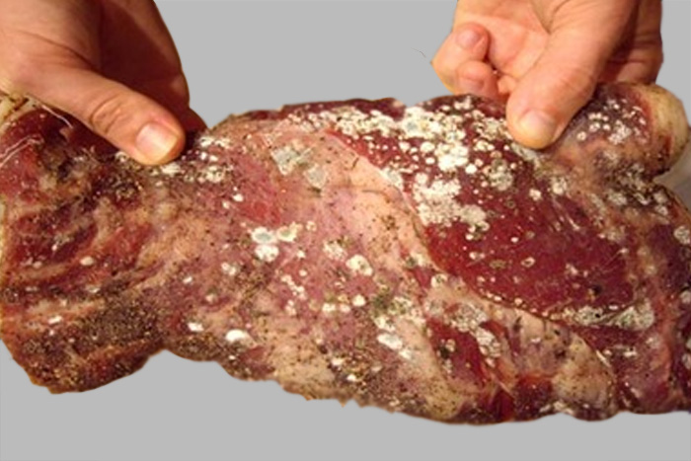
Meat inspection
Mr: saidi fussa
BSCehs-MUHAS

Slide 2
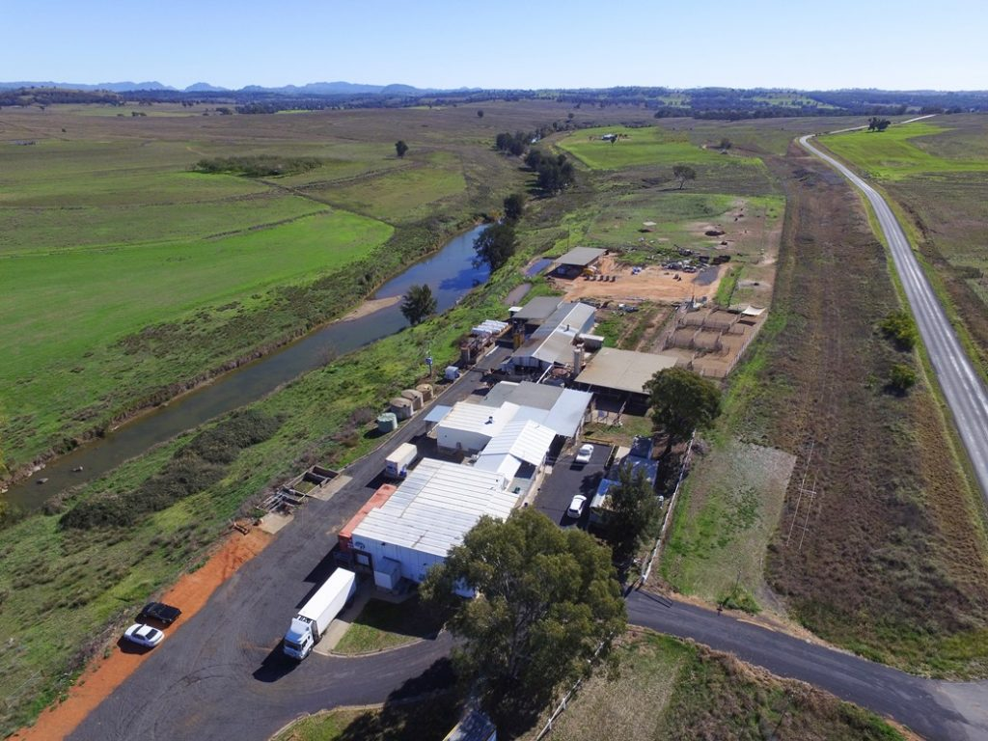
Abattoir design and operation

Slide 3
Abattoir
Slaughter house – technically referred as Abattoir.
Traditionally called butcheries, giving negative feeling due to foul smell, unhygienic disposal of wastes.
Slaughter house is a place where animals meant for human consumptions are sacrificed.
Abattoir is any establishment where specified animals are slaughtered and dressed for human consumption and that is approved, registered and/or listed by the competent authority for such purposes.

Slide 4
Types of abattoir
Modern abattoir
Semi-modern-Facilities for slaughter and bleeding on the floor but subsequently entire dressing, washing, halving and quartering takes place on the rails in hoist position
Traditional abattoir

Slide 5
Considerations
Policy decisions-
Site, size, trade practices and range of byproducts
Engineering aspects- layout plan
Cost consideration
Infrastructure depends upon the-
  Maximum daily kill
  A regular full time operation
  Disposal & treatment of waste
  Byproducts utilization

Slide 6
Selection of site
Outskirt of the town or city
Elevated ground for easy draining
Adequate and potable water
Concrete road facilities for transportation
Uninterrupted electric supply
Space for future expansion
Away from airport
Social and religious acceptance
Free from pollution, odour, chemical plants etc

Slide 7
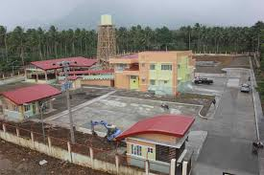
Contd--
Availability of skilled manpower
Availability of meat animals
Soil quality- to support good foundations and pillars of the buildings
Separate entity i.e. reasonable distance from other buildings
Separation of clean and dirty area

Slide 8
Size
Depends on
  Number of animals of each species to be slaughtered everyday
  Range of operation (slaughter/ dressing/ deboning/ packaging)
  Availability of fund
  Byproduct processing

Slide 9
Area requirement
Small Abattoir | < 100 LU/ day | 30,000 LU/year | 1-2 acre
Medium Abattoir | 100- 200 LU/day | 50,000LU/year | 2-4 acre
Large Abattoir | > 200 LU/day | > 1oo,ooo LU/year | 4-6 acre
LU – Livestock unit

Slide 10
Meat Inspection
It is a professional examination of meat and meat products for its fitness for human consumption.
Meat inspection is mandatory when animals are slaughtered and processed for sale.
Meat inspection prime objectives:
  To ensure that only apparently healthy, physiologically normal animals are slaughtered for human consumption and that abnormal animals are separated.
  To ensure that meat from animals is free from disease, wholesome and of no risk to human health.

Slide 11
IMPORTANCE OF MEAT (as food)
Important constituent of human diet.
Most nutritious and palatable food.
Provides proteins of high biological value, minerals, fatty acids and wide range of essential vitamins to the human body.

Slide 12
Chemical Composition of Meat
 | Beef | Mutton | Poultry
Water (%) | 60.0 | 55.8 | 71.2
Protein (%) | 17.5 | 15.7 | 20.2
Fat (%) | 22.2 | 27.7 | 7.2
Calories | 273 | 317 | 151
Iron (mg/100g) | 2.6 | 2.4 | 1.5

Slide 13
Prevailing Issues in Meat Sector
Unhygienic processing.
Health and environmental hazards.
There is no value addition of meat products.
Wastage of valuable byproducts.
No concept of quality meat production.

Slide 14
Cont..
Animals are slaughtered in slaughterhouse without the supervision of veterinarian
No modern meat technology system
No organized marketing system

Slide 15
How you can solve the prevailing issues of meat sector??
Hygiene
Modern meat technology
Marketing

Slide 16
Ante-mortem
Ante ( before), Mortem (death or slaughtering)
It is professional examination of those animals waiting for slaughtering OR
It is gross and clinical examination of live food animals before slaughtering

Slide 17
Objectives of Ante-mortem examination
To screen all animals destined to slaughter (either Halal or haram etc.).
To ensure that animals are properly rested & offered feed and water.
To reduce contamination on the killing floor by separating the dirty animals and condemning the diseased animals if required by regulation.
To ensure that injured animals or those with pain and suffering receive emergency slaughter and that animals are treated humanely.

Slide 18
Cont..
To identify reportable animal diseases to prevent killing floor contamination.
To identify sick animals and those treated with antibiotics, chemotherapeutic agents, insecticides and pesticides.
To require and ensure the cleaning and disinfection of trucks used to transport livestock.
To make sure that only healthy non pregnant animals should be slaughtered.

Slide 19
Cont..
To prevent the slaughtering of young animals e.g calves, less than one year of age animals
Animals showing clinical signs of disease should be held for veterinary examination and judgment.
Diseased are treated as “suspects” and should be segregated from the healthy animals.
The disease and management history should be recorded and reported on an A/M inspection card.

Slide 20
Other information should include:
Owner's name
The number of animals in the lot and arrival time
Species and sex of the animal
The time and date of antemortem inspection
Clinical signs and body temperature if relevant
Reason why the animal was held
Signature of veterinarian

Slide 21
CONT..
Antemortem inspection should be carried out in adequate lighting where the animals can be observed both collectively and individually at rest and motion.
The general behavior of animals should be observed, as well as their nutritional status, cleanliness, signs of diseases and abnormalities.
Taking the temperature of a suspect heifer

Slide 22
Some of the abnormalities which are checked on ante-mortem examination include:
Abnormalities in respiration
Abnormalities in behaviour
Abnormalities in gait
Abnormalities in posture
Abnormalities in structure and conformation
Abnormal discharges
Abnormal colour
Abnormal odour

Slide 23
CONT..
Abnormalities in respiration commonly refer to frequency of respiration. If the breathing pattern is different from normal the animal should be segregated as a suspect.
Abnormalities in behavior are manifested by one or more of the following signs. The animal may be:
  walking in circles or show an abnormal gait or posture
  pushing its head against a wall
  charging at various objects and acting aggressively
  showing a dull and anxious expression in the eyes

Slide 24
CONT..
Abnormal gait in an animal is associated with pain in the legs, chest or abdomen or is an indication of nervous disease.
Abnormal posture in an animal is observed as tucked up abdomen or the animal may stand with an extended head and stretched out feet. The animal may also be laying and have its head turned along its side. When it is unable to rise, it is often called a “downer”. Downer animals should be handled with caution in order to prevent further suffering.

Slide 25
CONT..
Abnormalities in structure (conformation):
Swellings (abscesses)
Enlarged joints
Umbilical swelling (hernia or omphalophlebitis)
Enlarged sensitive udder indicative of mastitis
Enlarged jaw (“lumpy jaw”)
Bloated abdomen

Slide 26
CONT..
Abnormal discharges:
Discharges from the nose, excessive saliva from the mouth, afterbirth
Protruding from the vulva, intestine
Protruding from the rectum (prolapsed rectum)
Protruding from the vagina (prolapsed uterus)
Growths on the eye and bloody diarrhea

Slide 27
CONT..
Abnormal colour:
Red areas on light coloured skin (inflammation), dark blue areas on the skin or udder (gangrene).
Abnormal odour:
is difficult to detect on routine A/M examination. The odour of an abscess, a medicinal odour, stinkweed odour or an acetone odour of ketosis may be observed. Since many abattoirs in developing countries have not accommodation station or yards for animals, Inspector's antemortem judgment must be performed at the admission of slaughter animals

Slide 28
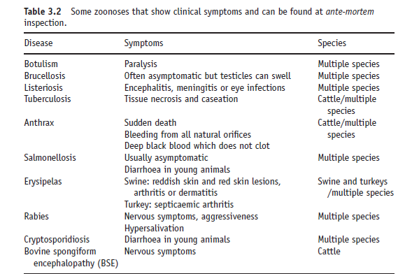

Slide 29
How we categorize the animals after antemortem inspection?
Animals could be judged into any one of the following categories:
Passed for slaughter (proceed to slaughter without undue delay).
Passed for a second ante-mortem (animals insufficiently rested, or are temporarily affected by a physiological or metabolic condition.).
Passed for slaughter under special conditions.
Condemned (due to the presence of meat-borne hazards, occupational health hazards).
Emergency slaughter.

Slide 30
Postmortem inspection
Covers the inspection of the carcasses and parts of meat and poultry used for human food.
It take place after the animal or poultry has been slaughtered thus the term “post-mortem,” meaning “after death” in Latin
It covers the steps in the slaughter process that begin at stunning and ends at the step where the carcass is placed in the cooler.

Slide 31
PM cont…
The purpose is to protect the public health by ensuring that the carcasses and parts that enter the market are wholesome, not adulterated, and properly marked, labeled, and packaged.
PM inspection involves making regulatory decisions, documenting findings, and taking enforcement actions when appropriate.

Slide 32
CONT…
The Public Health Act, 2009 Section 137 states that;
“Subject to the provisions of the Meat Industry Act, the Authority shall make necessary procedures to ensure that all meat or poultry intended for human consumption is inspected both at the ante
mortem and post mortem.”
"Authority" means a district authority or an urban authority;

Slide 33
Postmortem inspection should provide necessary information for the scientific evaluation of pathological lesions pertinent to the wholesomeness of meat.
Professional and technical knowledge must be fully utilized by:
  viewing, incision, palpation and olfaction techniques.
  classifying the lesions into one of two major categories - acute or chronic.
  establishing whether the condition is localized or generalized, and the extent of systemic changes in other organs or tissues.

Slide 34
  determining the significance of primary and systemic pathological lesions and their relevance to major organs and systems, particularly the liver, kidneys, heart, spleen and lymphatic system.
  coordinating all the components of antemortem and postmortem findings to make a final diagnosis.
  submitting the samples to the laboratory for diagnostic support, if abattoir has holding and refrigeration facilities for carcasses under detention.

Slide 35
Carcass judgment
There are three possible outcomes of the inspection.
  Passed, and thus eligible to receive the marks of inspection
  Suspect, which must be retained for veterinary disposition and
  Condemned, which is not eligible to receive the marks of inspection and cannot enter commerce
Trimming or condemnation may involve:
  Any portion of a carcass or a carcass that is abnormal or diseased.
  Any portion of a carcass or a carcass affected with a condition that may present a hazard to human health.
  Any portion of a carcass or a carcass that may be repulsive to the consumer.

Slide 36
Localized versus generalized conditions
In a localized condition, a lesion is restricted by the animal defense mechanisms to a certain area or organ.
In a generalized condition, the animal's defense mechanisms are unable to stop the spread of the disease process by way of the circulatory or lymphatic systems.
Some of the signs of a generalized disease are:
  Generalized inflammation of lymph nodes including the lymph nodes of the head, viscera and/or the lymph nodes of the carcass
  Inflammation of joints

Slide 37
Cont.….
  Lesions in different organs including liver, spleen kidneys and heart
  The presence of multiple abscesses in different portions of the carcass including the spine of ruminants
Generalized lesions usually require more severe judgement than localized lesions.

Slide 38
Acute versus chronic conditions
Acute conditions
The acute stage is manifested by inflammation of different organs or tissues, enlarged haemorrhagic lymph nodes and often by petechial haemorrhage of the mucosal and serous membranes and different organs such as heart, kidney and liver.
An acute stage parallels with the generalized disease complex, when an acute infection tends to overcome the animal's immune system and becomes generalized.
In this case, each systemic lesions should be assessed individually taking into account the significance that these lesions have towards major organ systems

Slide 39
Cont……..
Chronic conditions
Inflammation associated with congestion is replaced by adhesions, necrotic and fibrotic tissue or abscesses.
The judgement in the chronic stage is less severe and frequently the removal of affected portions is required without the condemnation of the carcass

Slide 40
MINIMUM POSTMORTEM INSPECTION REQUIREMENTS
The post-mortem inspection process for livestock involves the following steps:
  head inspection,
  viscera inspection, and
  carcass inspection
No step in the inspection process may be omitted.

Slide 41
HEAD
It should be inspected before the carcass to facilitate the operations
The inspector must perform visual examination of the outer surfaces and eyes
Then an inspection of the gums, lips and tongue for foot-and mouth disease, necrosis and other forms of stomatitis, actinomycosis and actinobacillosis.
Palpate the tongue from the dorsum to the tip and make a longitudinal incision on ventral surface of the tongue

Slide 42
Cont.……….
Incisions of the internal and external masseters for C. bovis should be made parallel with the lower jaw.
After the tongue is dropped, routine incisions of the retropharyngeal, submaxillary and parotid lymph nodes should be made for tuberculous lesions, abscesses and actinobacillosis

Slide 43
Head cont…
bovine medial retropharyngeal lymph nodes close to the
palatine tonsils.
Section of bovine masseter muscle
Parotid lymph node, evidenced by a section between the masseter muscle and
acoustic meatus.
Submaxillary lymph nodes in bovine, shown by the black arrow, visible sidewise to
the root of tongue.

Slide 44
viscera
Lungs
Perform visual examination followed by palpation for evidence of pleurisy, pneumonia, TB, fascioliasis, hydatid cysts, etc.
The bronchial and mediastinal lymph nodes should be incised.
The lung substance should be exposed by by a transverse incision across the diaphragmatic lobes
Bovine mediastinal lymph nodes located near the bronchus of the right cranial
lobe.

Slide 45
Cont….
Heart
The pericardium should be examined for evidence of pericarditis, hemorrhages, etc. and then pealed off.
The ventricles are then incised, and the outer and inner surfaces are observed, particular attention being paid to the presence of petechial hemorrhages on the epicardium or endocardium and to cysticerci, hydatid cysts and occasionally linguatulae in the myocardium.
A flabby condition of the myocardium is often associated with septic conditions in the cow
The auricular face of pig heart.
Internal view of the left ventricular cavity of bovine heart.

Slide 46
Cont…..
Liver
A visual examination with palpation should be made on both sides for fatty change, actinobacillosis, abscesses, telangiectasis and parasitic infections such as hydatid cysts, C. bovis, fascioliasis or linguatulae.
Observe and, if necessary, palpate the gall bladder.
Incise the bile ducts and liver substance by making two transverse and one longitudinal incisions
Visceral face of pig liver with gall bladder.

Slide 47
Cont….
Spleen
The surface and substance should be examined for TB, haematoma and the presence of infarcts with observation, palpation and, if necessary, make a longitudinal incision
Parietal face of pig spleen.
Visceral face of pig spleen.

Slide 48
Cont…..
Oesophagus, stomach and intestines
Observe and, if necessary, palpate these organs.
The serous surface may show evidence of TB or actinobacillosis, while the anterior aspect of the reticulum may show evidence of a foreign body.
Kidney
Enucleation of the kidney to allow visual inspection and, if necessary, make longitudinal incision of the kidney and renal lymph nodes for Artifacts, hydronephrosis and cysts
Jejunal lymph nodes along the mesentery in pig

Slide 49
Carcasses
The cut surfaces of bone and muscle, carcass exterior, pleura, peritoneum and diaphragm should be observed, attention being given to condition, efficiency of bleeding, colour, cleanliness, odours and evidence of bruising and other abnormalities.
Perform transverse incision of triceps brachii muscle for C. bovis.
The superficial inguinal, external and internal iliac, prepectoral and renal lymph nodes should be observed and, if necessary, palpated and incised.
The thoracic and abdominal cavities should be inspected for inflammation, abscesses, actinobacillosis, mesothelioma or TB.
The diaphragm should be lifted, for tuberculous lesions may be hidden between the diaphragm and the thoracic wall.

Slide 50
Abattoir waste disposal
Abattoir waste disposal methods and on-farm disposal of carcasses must be performed in such a manner as to protect the environment and human health.
The protection of groundwater, surface water and air quality are essential while reducing the risk of disease transmission and effectively preventing access to scavengers and controlling excessive fly activity.
Disposal methods need to be economically feasible and socially acceptable

Slide 51
On-site Disposal Options
Abattoir waste and carcasses may be disposed on-site through;
  Composting
  Burial
  Incineration
Proper site selection for any disposal method is integral in protecting the environment and human health
Must consider existing land use around the abattoir and disposal site

Slide 52
Composting
It is a biological process in which organic materials are broken down and nutrients are concentrated within mature compost.
It involves layering of abattoir waste or carcasses between absorbent carbon sources of material such as wood chips/shavings/ bark, barn animal bedding, hay, straw, etc, in a static pile.

Slide 53
Composting cont…
A proper ratio of Carbon and Nitrogen sources must be maintained for appropriate composting.
The temperatures achieved during composting will normally kill or greatly reduce most pathogens.
Properly composted material is environmentally safe and a valuable soil amendment for growing crops.

Slide 54
Burial
Means put in the ground and covered with earth sufficiently to prevent access by scavengers
It does NOT include being deposited in an open pit for disposal by wildlife scavengers.
The burial site shall not be located within protected areas
No waste other than the abattoir waste or carcasses shall be deposited at the site
The abattoir waste/ carcasses shall be covered with a minimum of one (1) meter of soil.
The burial location should be recorded

Slide 55
Incineration
Incineration may be used to dispose of all abattoir waste or carcasses.
The facility must be approved by the competent authority to offer such services.

Slide 56
Off-site Disposal Options
Off-site disposal of infectious abattoir materials and bovine carcasses require approval and permits for each step taken; transportation, disposal (land fill, composting, incineration, burial) or end use.
The methods includes;
  Landfill
  Rendering
  Incineration
  Composting/burial

Slide 57
Landfill
Non infectious abattoir waste may be disposed at a municipal landfill.
Infectious abattoir waste and bovine carcasses may be disposed only at the municipal approved landfills.
In all cases, the landfill operator must approve acceptance of the material.

Slide 58
Rendering
A process that converts waste animal tissue into stable, value-added materials.
The materials can include the fatty tissue, bones, offal as well as entire carcasses of condemned animals from slaughterhouses, died farms, in transit etc
Non-infectious materials may be sent to any approved rendering facility
Infectious materials may only be sent to a facility approved by the competent authority

Slide 59
Animal byproducts from abattoir

Slide 60
Animal by-products
Animal by-products are defined as entire bodies or parts of animals, products of animal origin or other products obtained from animals that are not intended for human consumption‟.
This includes slaughterhouse waste, blood, feathers, wool, hides and skins, fallen stock, manure etc.

Slide 61
Categories of “animal by-products”
Category 1 Material
  Highest risk materials
  Consists principally of material that is considered a TSE (Transmissible Spongiform Encephalopathy) risk such as those parts of an animal considered most likely to harbor a disease such as BSE in cattle.
Category 2 Material
  High risk material
  Includes fallen stock, manure and digestive content.

Slide 62
Categories…
Category 3 Material
  Low risk materials.
  Includes parts of animals that has been passed fit for human consumption in a slaughterhouse but which are not intended for consumption, either because they are not parts of animals that we normally eat (hides, hair, feathers, bones etc) or for commercial reasons.

Slide 63
Disposal and use of animal by-products
Category 1 material
Disposal
  As the highest risk material, must be destroyed by incineration, or by rendering followed by incineration.
Use
  Can be used as a fuel for combustion
  Can also be used for the manufacture of derived products such as medical devices.

Slide 64
Category 2 material
Disposal
  Incineration or rendering followed by incineration.
  Can also be pressure-rendered and disposed of in an authorized landfill site
Use
  As category 1 materials
  Can be pressure-rendered and then used for the production of organic fertilizers and soil improvers.
  Can also be pressure-rendered and used in an approved composting or anaerobic digestion plant.
  Manure, digestive tract content, milk and milk based products and colostrum may be applied directly to land without processing provided there is no risk of transmitting a disease.

Slide 65
Category 3 materials
Disposal
  Can be incinerated, or rendered followed by incineration.
  Can also be rendered followed by disposal in an authorized landfill (no need for pressure rendering).
Use
  As category 1
  can be rendered for the production of organic fertilizers or soil improvers.
  Can also be used in the production of animal feeding stuffs
  Can be used directly in approved composting or anaerobic digestion plants, and in the production of raw pet food.
  Raw milk, colostrum and products derived from these can be applied directly to land provided there is no risk of transmitting a disease.

Slide 66
Collection, identification and transport of Animal by-products
Must be collected, identified and disposed of without undue delay, in order to prevent risks arising to public and animal health.
Must be transported in sealed new packaging or covered leak-proof containers or vehicles.
Containers must dedicated to the use of specific categories of animal by-products and where they are not they must be cleaned and disinfected after each use in order to prevent cross contamination.
They must be collected and identified by category.
Mixtures of different categories of animal by-products must be treated as the higher or highest risk of the mixed materials
e.g. category 3 material + category 2 material = category 2 material.

Slide 67
Labelling
Category 3 material must be labelled as “not for human consumption‟.
Category 2 material must be labelled “not for animal consumption‟
Category 1 material must be labelled as “for disposal only‟.

Slide 68
Transportation
Applied for category 3 material
The commercial document must record;
  The date on which the material is taken from the premises;
  A description of the material;
  the quantity of the material, in weight or volume;
  the place of origin of the material;
  the name and address of the transporter;
  the name and address of the receiver and its approval or registration number if appropriate; and
  the approval or registration number of the plant of origin if appropriate.

Slide 69
Use of animal by-products in research and other specific purposes
Authority may authorize the use of animal byproducts in research establishments and for specific purposes such as for diagnostic or educational purposes, under conditions which ensure the control of risks to public and animal health.
They must still be disposed of in accordance with the Regulation

Slide 70
THANKS FOR LISTENING

